Slide 1
DEVSECOPS

Slide 2





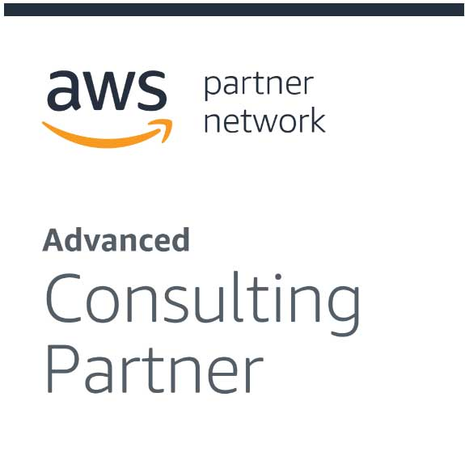


About CloudThat​
9+
350k+
100+
100+
350+
Years in Business
Professional Trained
Corporates Trained
Projects Delivered
Cloud Certifications
Leader in Training and Consulting on Cloud, Security, AI/ML, IoT and DevOps
Trained over 350k+ professionals across technologies and geographies
Proven track record of training delivery for all stages of employee lifecycle
Strong team of 125+ certified cloud experts with
industry consulting experience
Robust consulting division brings industry prospective to training delivery
Page 2

Slide 3






Trainer Profile
VENKATA SUBBARAO B Cloudthat Consultant UI | UX | JAVA Full Stack | Architect | Cloud | DevSecOps | SRE | DS | ML | AI | SOFT SKILLS
Cloud & Other Platforms
AWS, AZURE, GCP, Solution Architect,
DevSecOps, SRE
Front End
ES.Next, JavaScript, React, React Native, Vue, Angular Ext JS, UXD, UI , HTML, CSS, Bootstrap, Tailwind CSS, SASS, Wire Framing , Low & High Fiddle Design, RWD, PWA …
COGNIZANT
CRIO.DO
JIGSAW ACADEMY
TELSTRA
UNEXT
BAJAJ FINSERVE
Back End
MANIPAL PRO LEARN
ETEAMINC
PROBITS
MANTT
AWIGN
MYYESM
JAVA, Spring Boot, Node, ExpressJS, PHP, Python, SQL(MySQL, PgSQL), NoSQL (Mongo, Firebase, Elasticsearch, Cassandra, Couchbase), API
ANTHEM
UST-GLOBAL
MAZENET
TATA SED
HONDA USA
COLORS SOFT
Miscellaneous Tools
TRAINING CURVE
6BENCHES
EDUPINNACLE
AIMS MBA COLLEGE
VERZEO
Docker, Kubernetes, Jenkins, Kafka, Ansible, Terraform, SonarQube, Selenium, Atlassian Stack, Grafana, GraphQL, ELK Stack, Git, SVN, CVS, Redux, MobX, Thunk, Saga, Figma, Adobe XD, Karma & Jasmine, Protractor, Jest, SonarQube, Photoshop, Illustrator, Digital Marketing, Agile Scrum …
INVENTATEQ
CODING SUPER STAR
VSN TRADERS
IMPACT FOUNDATION
CRAYONZE
https://www.linkedin.com/in/bvsrao-venkat-4014133b/

Slide 4
AGENDA:
Software Development Evolution
What is DevOps?
What is DevSecOps?
DevOps vs DevSecOps
Benefits from implementing DevSecOps
Tools Used in DevSecOps
Enhance the software development lifecycle
Debunk Common myths
DevSecOps Best Practices

Slide 5
PREREQUISITES:
No Prior Knowledge Required

Slide 6
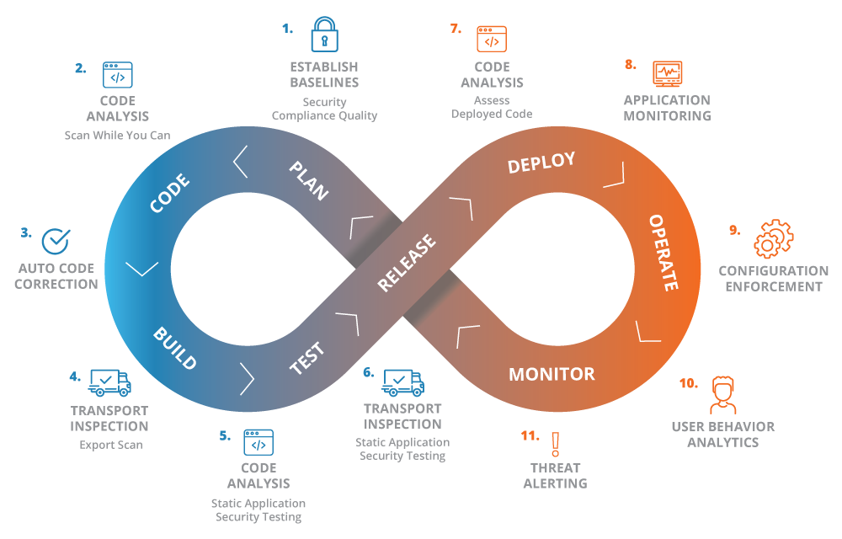
DEVSECOPS
DevOps and security teams have historically operated in silos, leaving huge gaps in application security and making apps more prone to attacks. DevSecOps presents a modern approach that embeds security throughout the application lifecycle to reduce risks.

Slide 7
Software Development Evolution
SDLC Quick Overview
Agile & Scrum Methodology
DevOps
DevSecOps

Slide 8
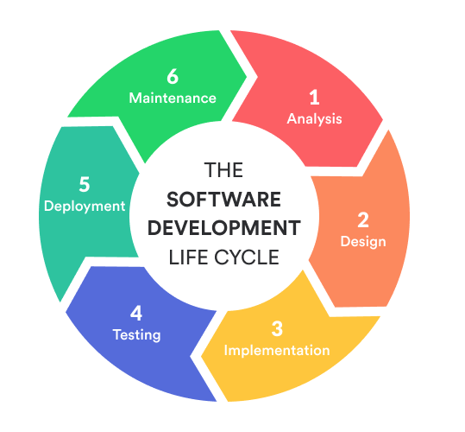
SDLC

Slide 9
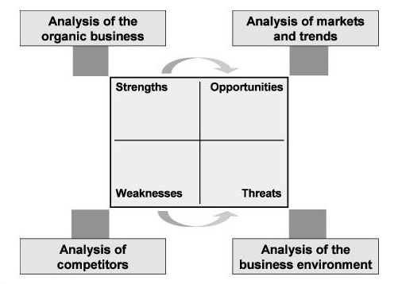
Planning and Requirement Analysis
Requirement analysis is the most important and fundamental stage in SDLC. It is performed by the senior members of the team with inputs from the customer, the sales department, market surveys and domain experts in the industry. This information is then used to plan the basic project approach and to conduct product feasibility study in the economical, operational and technical areas.
Planning for the quality assurance requirements and identification of the risks associated with the project is also done in the planning stage. The outcome of the technical feasibility study is to define the various technical approaches that can be followed to implement the project successfully with minimum risks.

Slide 10
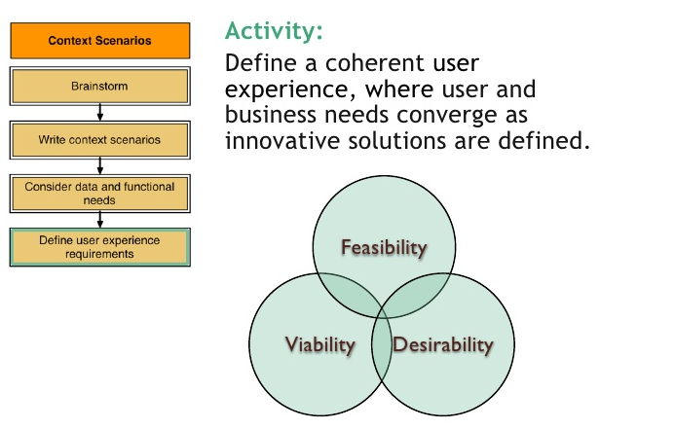
Defining Requirements
Once the requirement analysis is done the next step is to clearly define and document the product requirements and get them approved from the customer or the market analysts. This is done through an SRS (Software Requirement Specification) document which consists of all the product requirements to be designed and developed during the project life cycle.

Slide 11
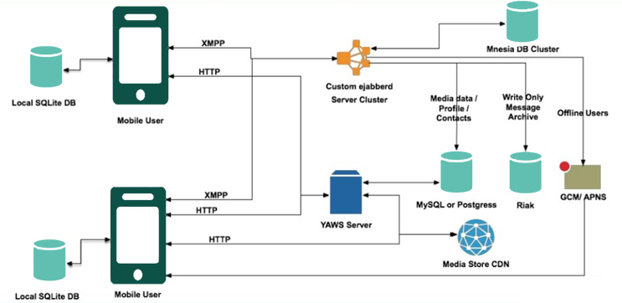
Designing the Product Architecture
SRS is the reference for product architects to come out with the best architecture for the product to be developed. Based on the requirements specified in SRS, usually more than one design approach for the product architecture is proposed and documented in a DDS - Design Document Specification.
This DDS is reviewed by all the important stakeholders and based on various parameters as risk assessment, product robustness, design modularity, budget and time constraints, the best design approach is selected for the product.
A design approach clearly defines all the architectural modules of the product along with its communication and data flow representation with the external and third party modules (if any). The internal design of all the modules of the proposed architecture should be clearly defined with the minutest of the details in DDS.

Slide 12
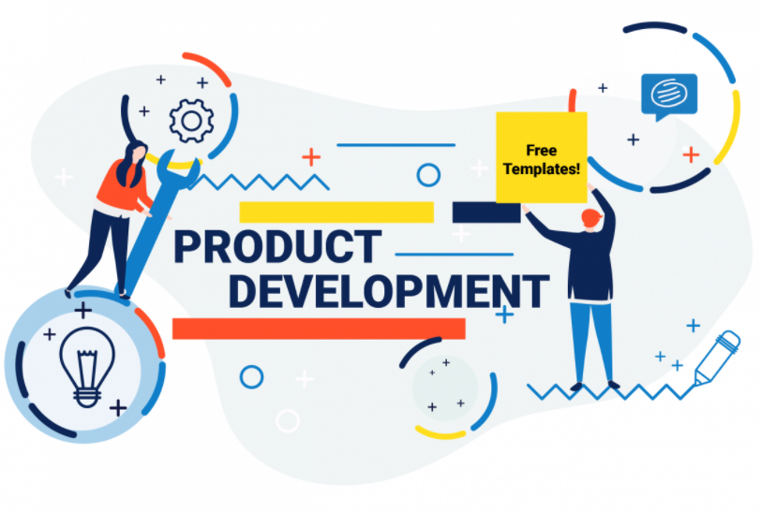
Building or Developing the Product
In this stage of SDLC the actual development starts and the product is built. The programming code is generated as per DDS during this stage. If the design is performed in a detailed and organized manner, code generation can be accomplished without much hassle.
Developers must follow the coding guidelines defined by their organization and programming tools like compilers, interpreters, debuggers, etc. are used to generate the code. Different high level programming languages such as C, C++, Pascal, Java and PHP are used for coding. The programming language is chosen with respect to the type of software being developed.

Slide 13
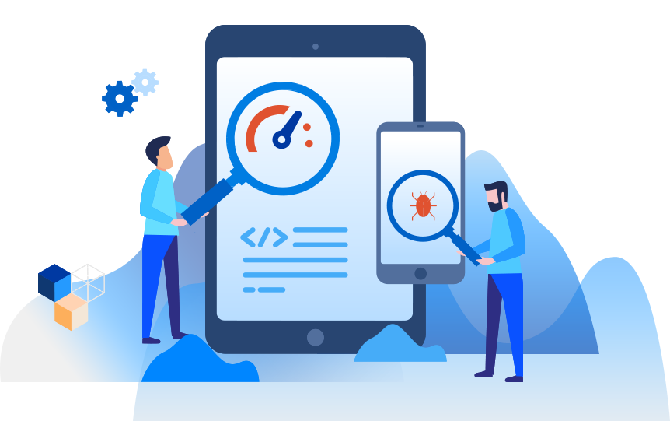
Testing the Product
This stage is usually a subset of all the stages as in the modern SDLC models, the testing activities are mostly involved in all the stages of SDLC. However, this stage refers to the testing only stage of the product where product defects are reported, tracked, fixed and retested, until the product reaches the quality standards defined in the SRS.

Slide 14
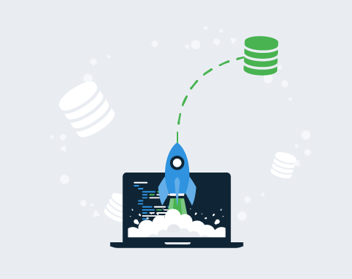
Deployment in the Market and Maintenance
Once the product is tested and ready to be deployed it is released formally in the appropriate market. Sometimes product deployment happens in stages as per the business strategy of that organization. The product may first be released in a limited segment and tested in the real business environment (UAT- User acceptance testing).
Then based on the feedback, the product may be released as it is or with suggested enhancements in the targeting market segment. After the product is released in the market, its maintenance is done for the existing customer base.

Slide 15
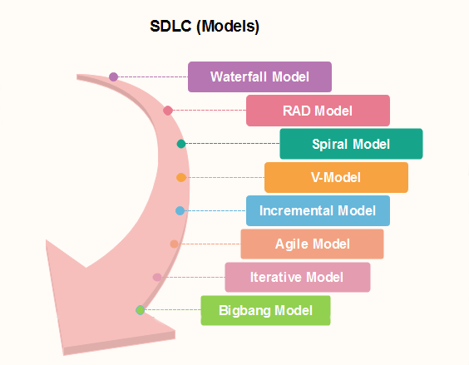
SDLC Models

Slide 16
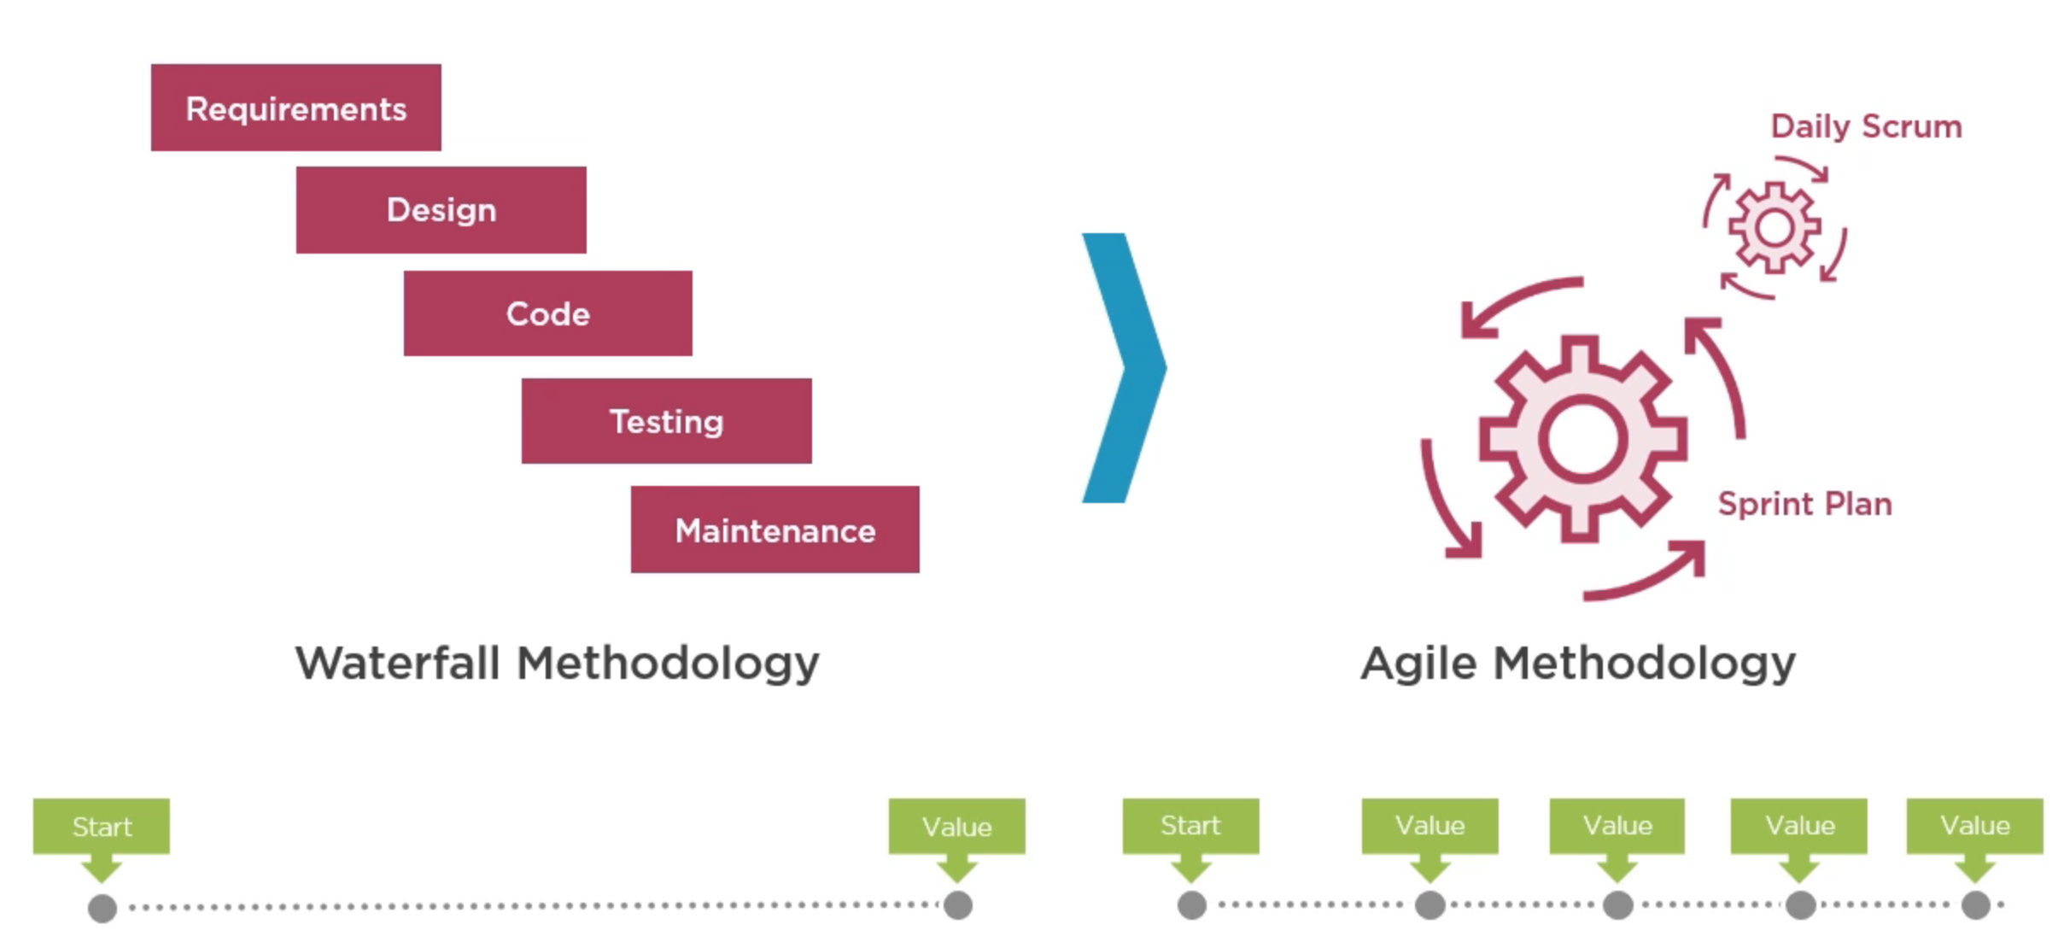
Software Development Evolution

Slide 17

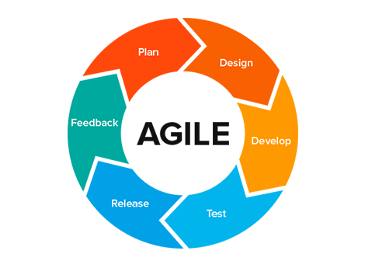
Agile

Slide 18
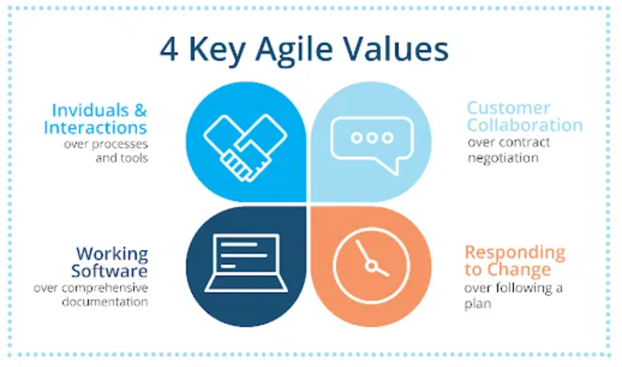
4 KEY VALUES

Slide 19
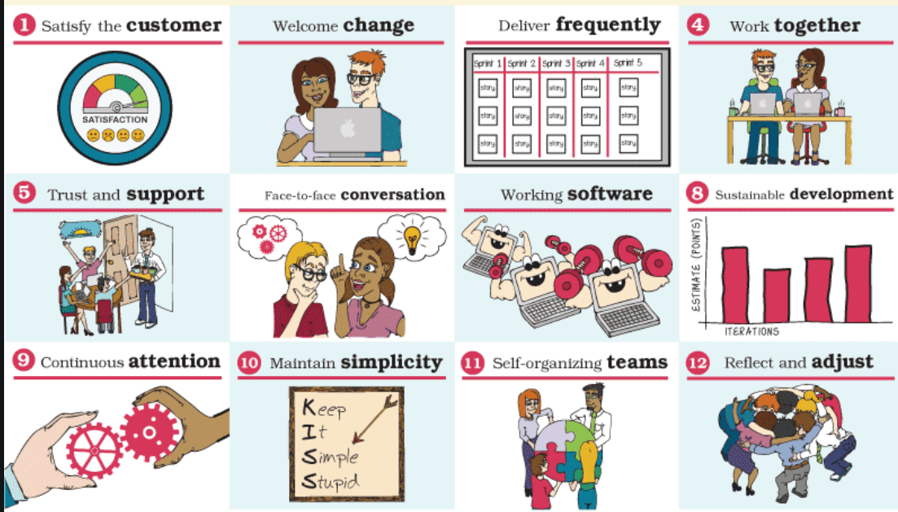
12 PRINCIPLES

Slide 20
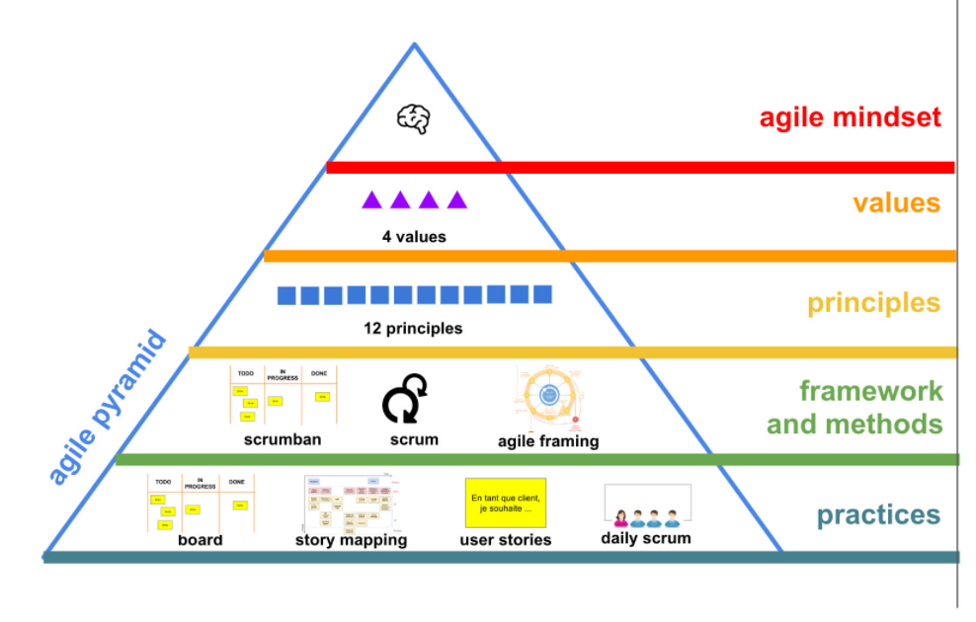

Slide 21
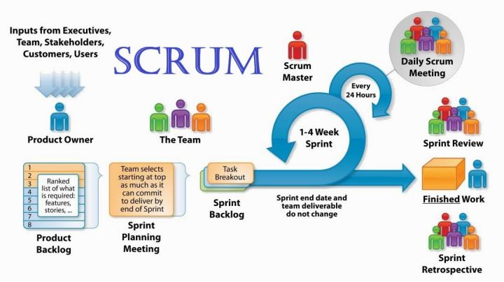
Scrum

Slide 22
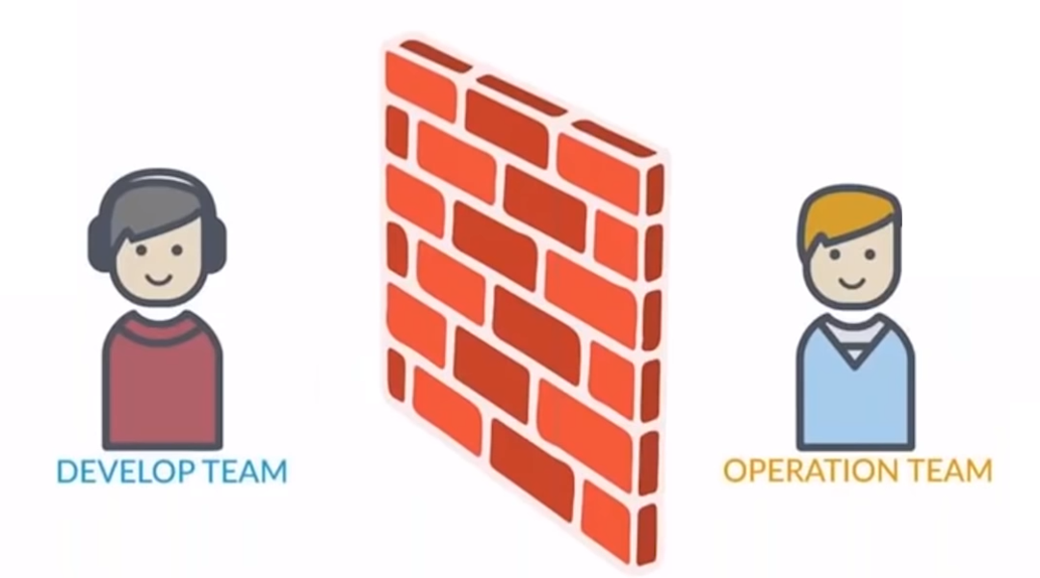
Agile Limitations
Code works fine in my laptop
There is some problem with the code it does not work in production

Slide 23
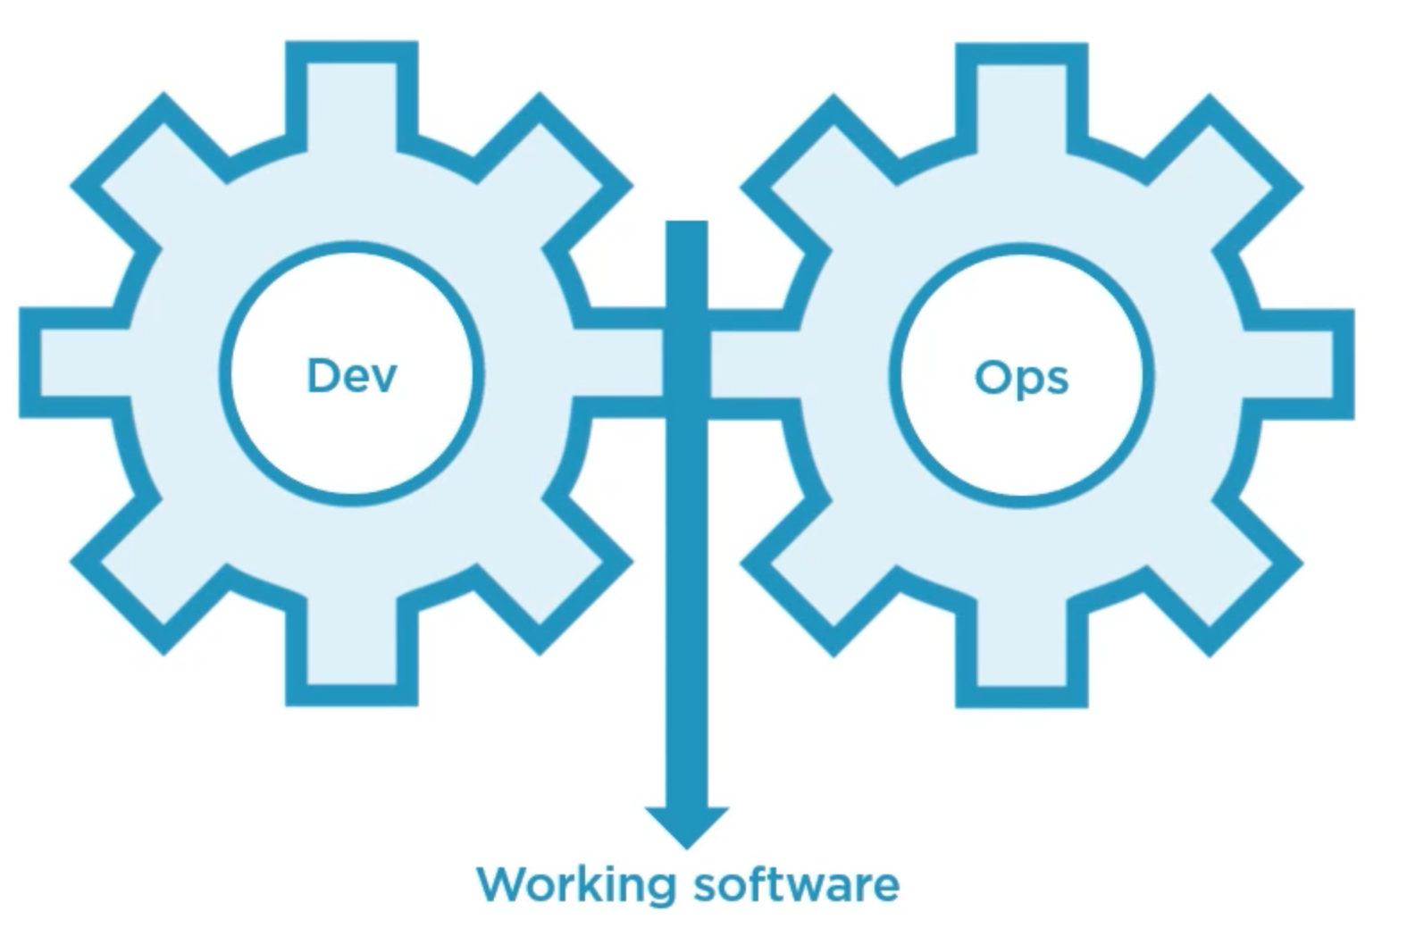
Solution is DevOps

Slide 24
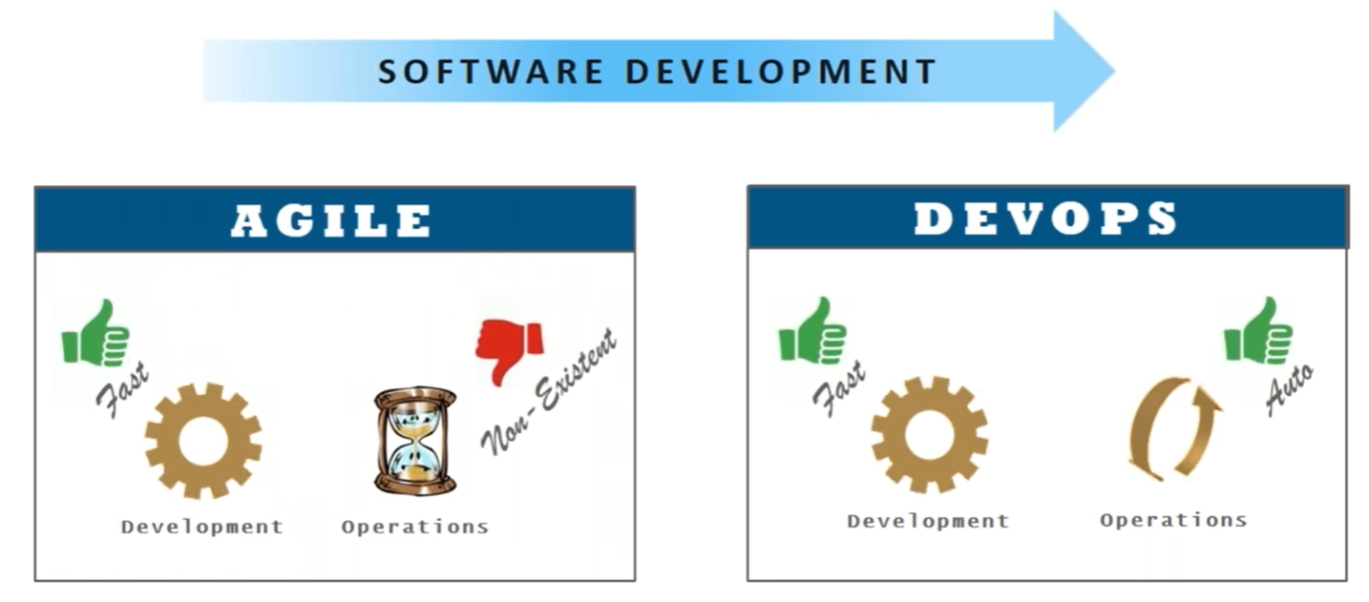
Agile vs DevOps

Slide 25
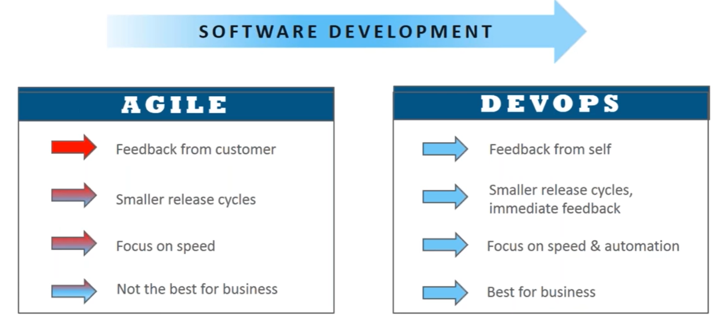
Agile vs DevOps

Slide 26
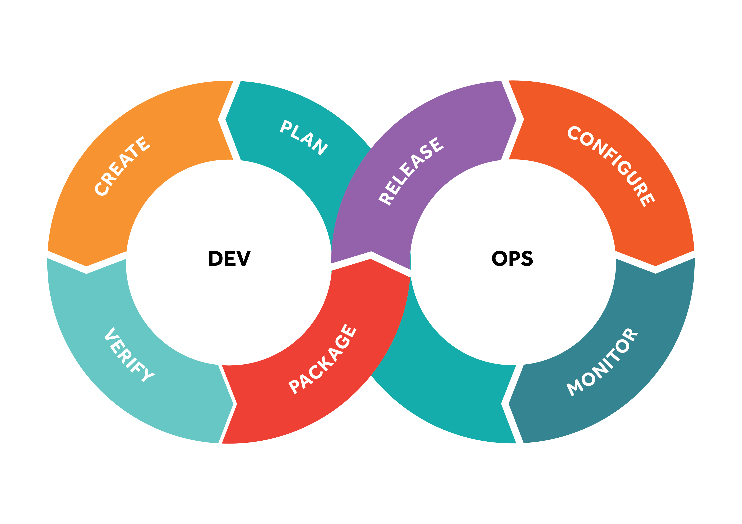
DevOps
DevOps is a set of practices that combines software development and IT operations. It aims to shorten the systems development life cycle and provide continuous delivery with high software quality. DevOps is complementary with Agile software development; several DevOps aspects came from the Agile methodology.

Slide 27
How DevOps Works?
Under a DevOps model, development and operations teams are no longer “siloed.” Sometimes, these two teams are merged into a single team where the engineers work across the entire application lifecycle, from development and test to deployment to operations, and develop a range of skills not limited to a single function.
In some DevOps models, quality assurance and security teams may also become more tightly integrated with development and operations and throughout the application lifecycle. When security is the focus of everyone on a DevOps team, this is sometimes referred to as DevSecOps.
These teams use practices to automate processes that historically have been manual and slow. They use a technology stack and tooling which help them operate and evolve applications quickly and reliably. These tools also help engineers independently accomplish tasks (for example, deploying code or provisioning infrastructure) that normally would have required help from other teams, and this further increases a team’s velocity.

Slide 28
DevOps Benefits
Speed
Rapid Delivery
Reliability
Scale
Improved Collaboration
Security

Slide 29
DevOps Stages
Version Control
Continuous Integration
Continuous Delivery
Continuous Deployment
Continuous Monitoring

Slide 30
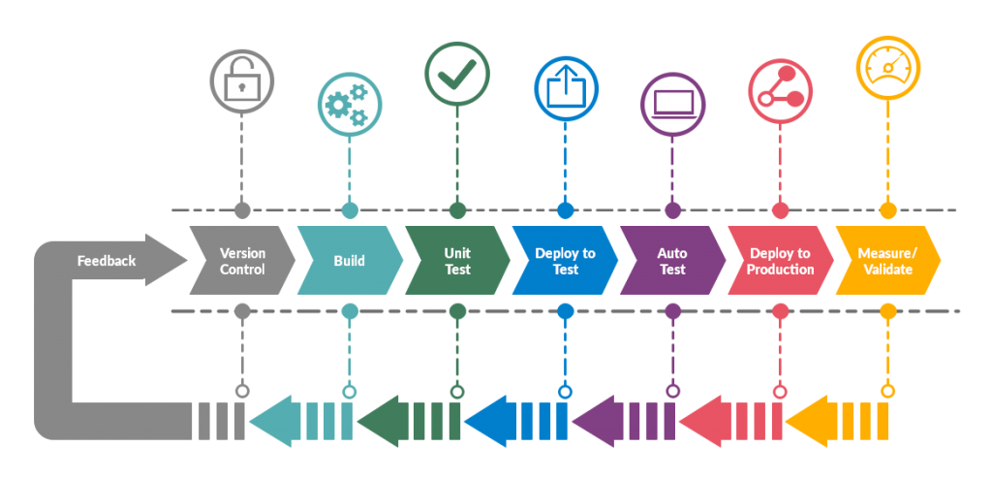
DevOps Pipeline

Slide 31
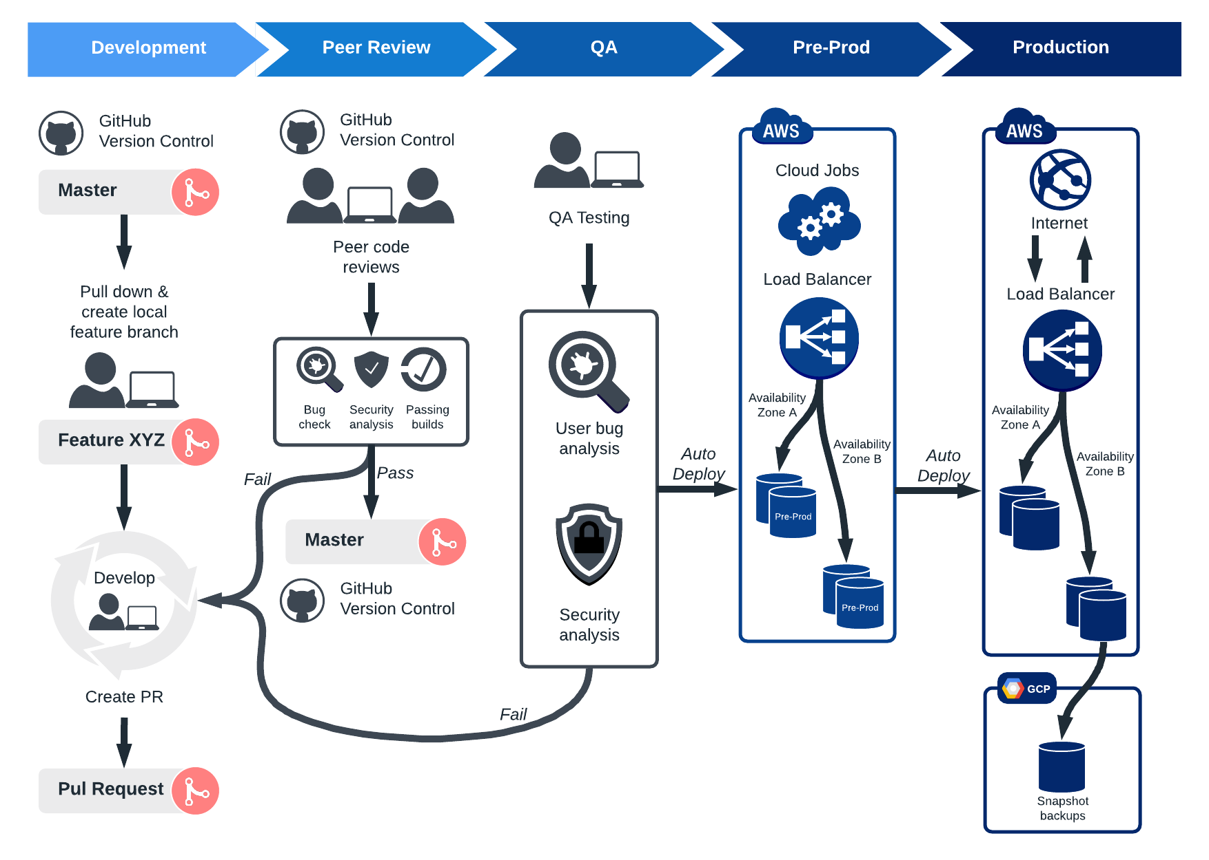

Slide 32
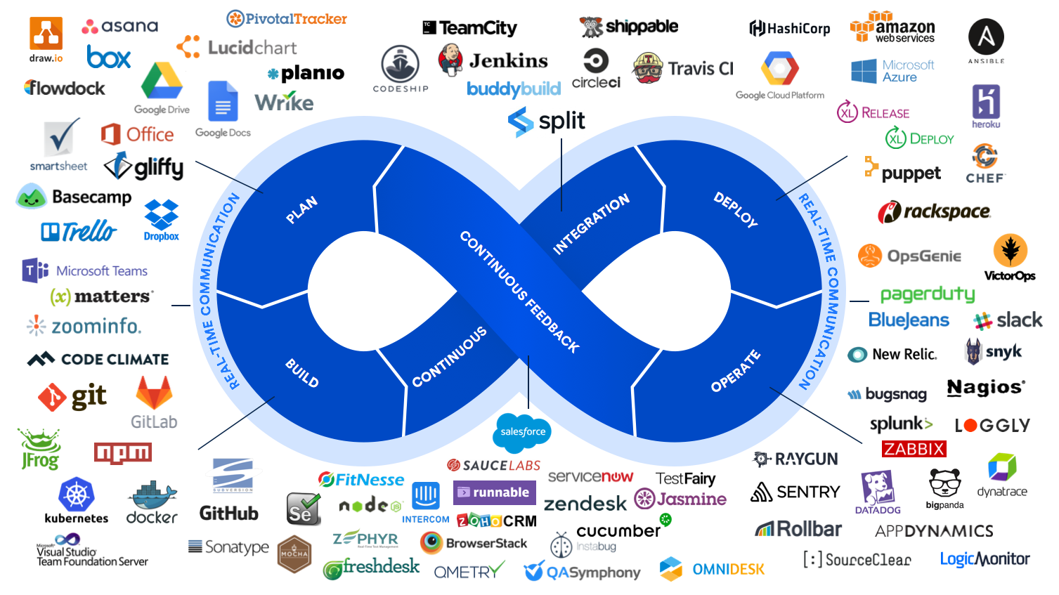

Slide 33
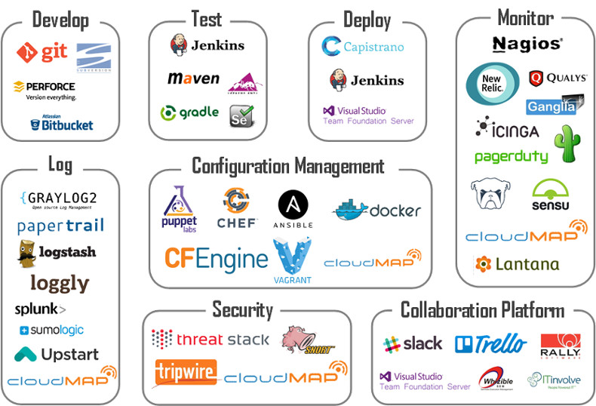
DevOps Tools

Slide 34
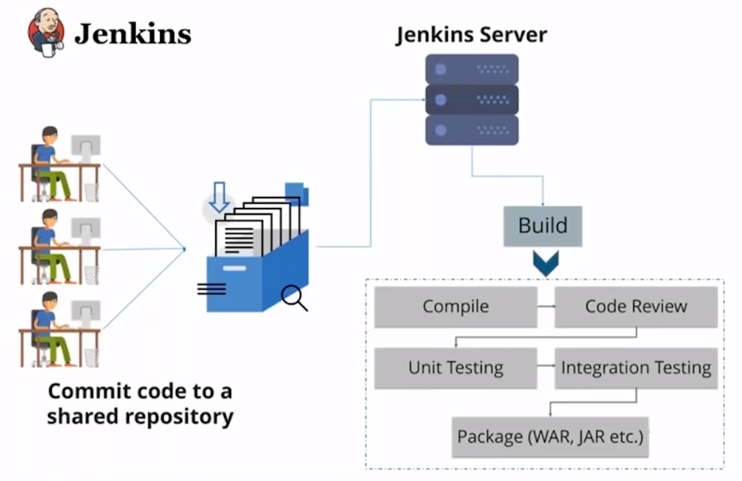
Continuous Integration

Slide 35
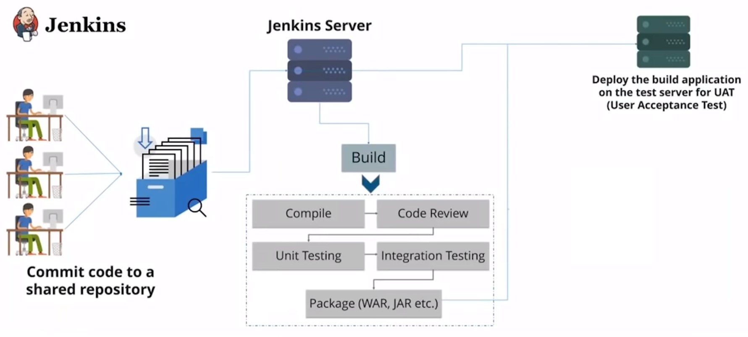
Continuous Delivery

Slide 36
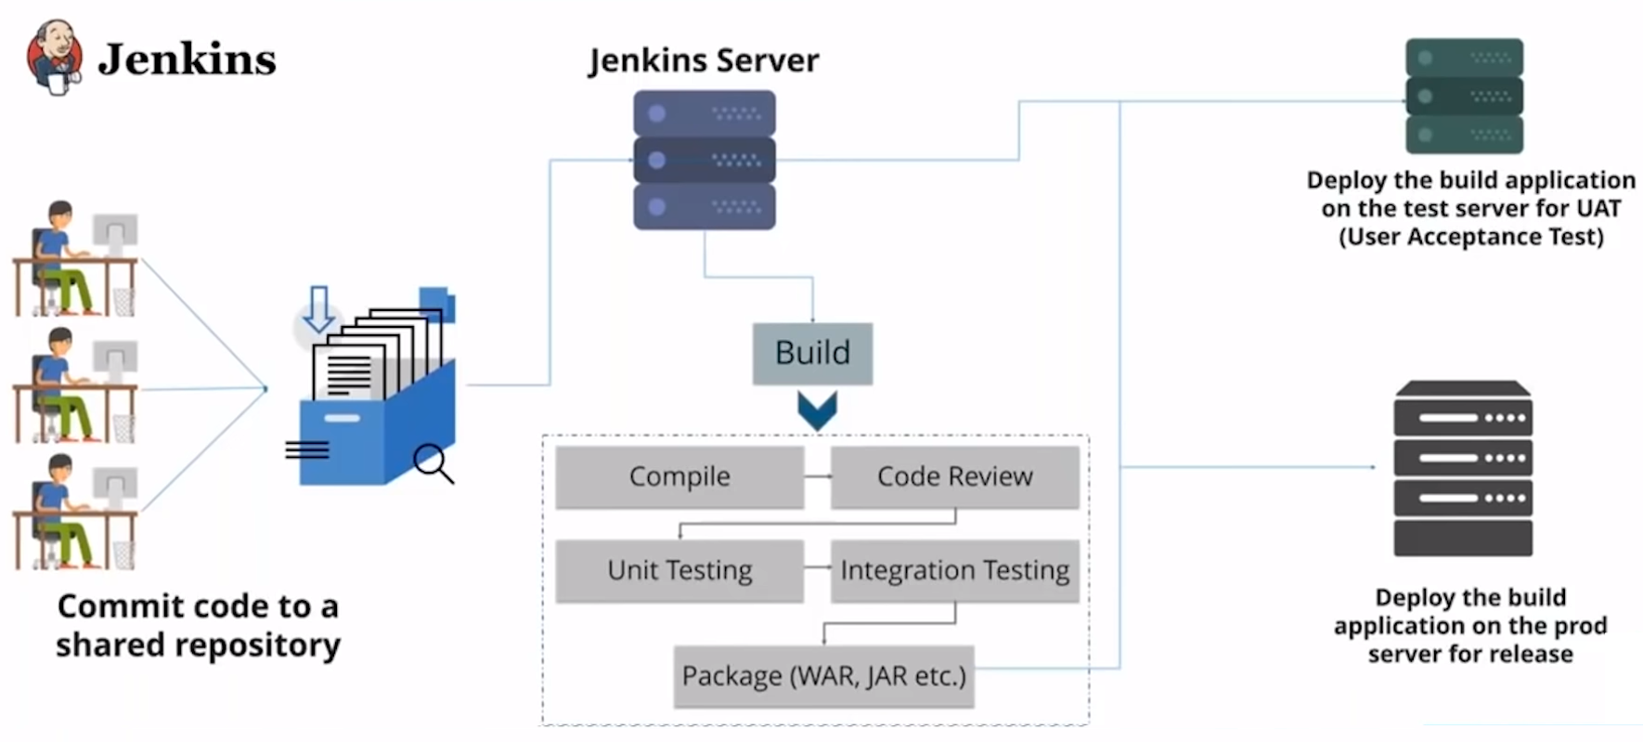
Continuous Deployment

Slide 37
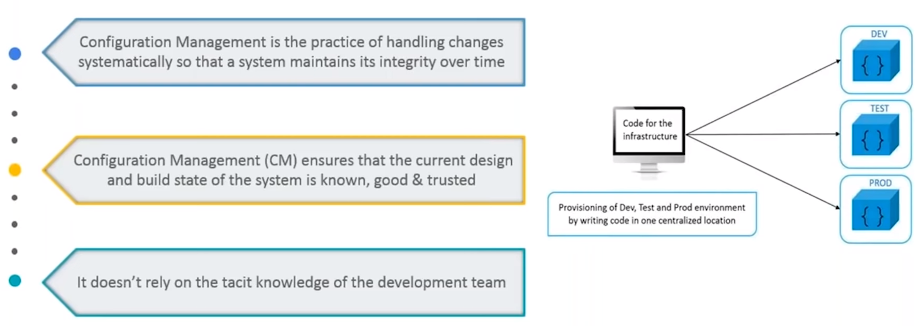
Configuration Management

Slide 38
DevOps Practices
Continuous Integration
Continuous Delivery
Micro Services
Infrastructure As a Code
Configuration Management
Monitoring and Logging
Communication and Collaboration

Slide 39
DevOps Best Practices
Incident Command System
Developers On call
Public Status Image
Blameless Post-mortems
Embedded Teams
Cloud
Andon Cords
Dependency Injection
Blue/Green Deployment
Chaos Monkey

Slide 40

Containerization vs Virtualization

Slide 41
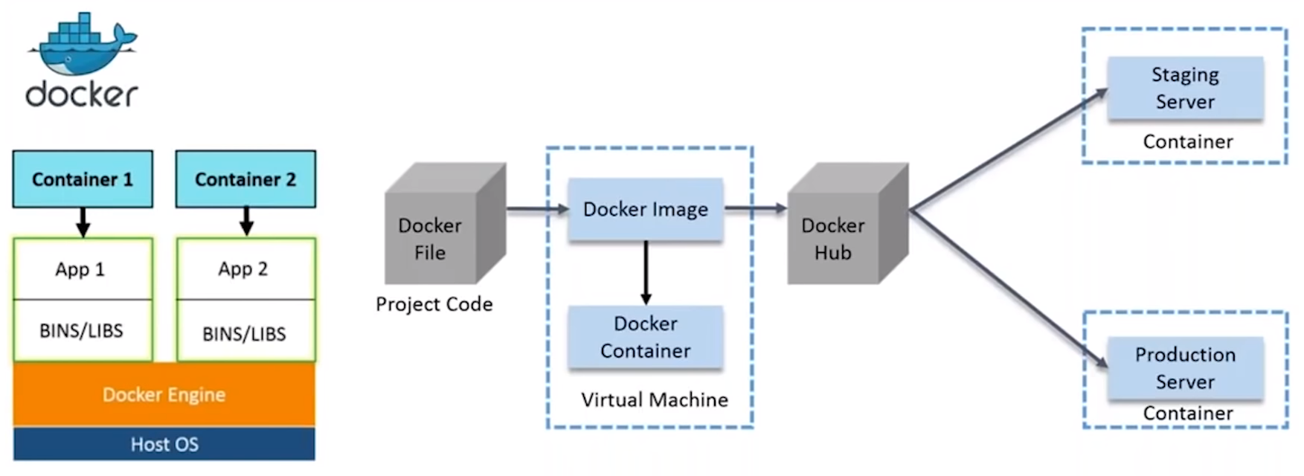
Docker

Slide 42
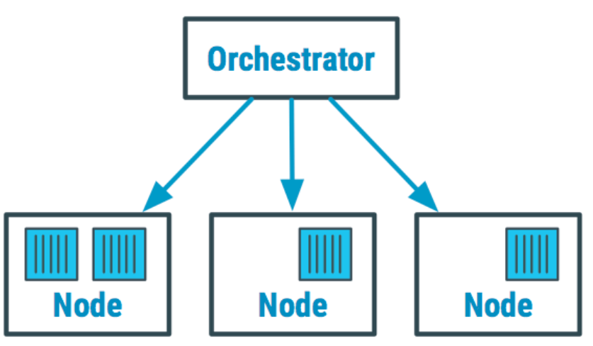
Container Orchestration
Container orchestration is the automation of much of the operational effort required to run containerized workloads and services. This includes a wide range of things software teams need to manage a container's lifecycle, including provisioning, deployment, scaling (up and down), networking, load balancing and more.

Slide 43

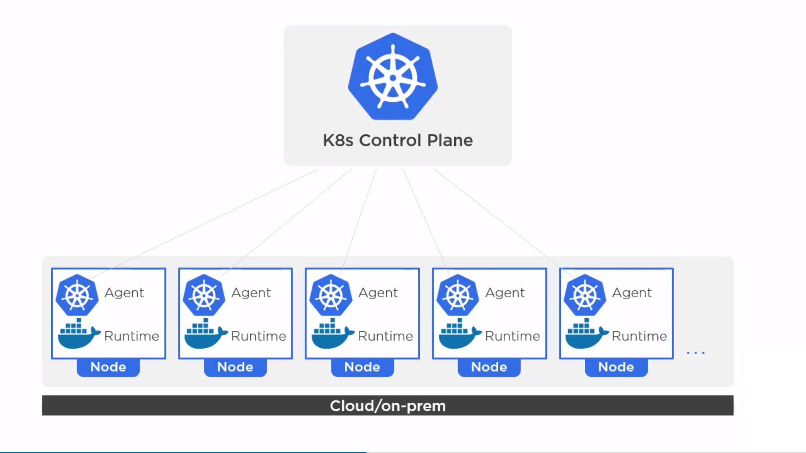
Kubernetes

Slide 44
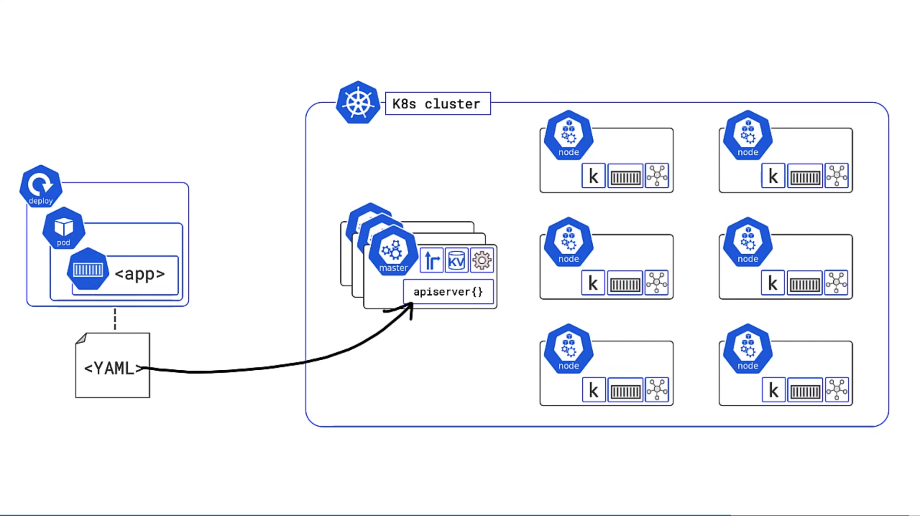
Kubernetes

Slide 45
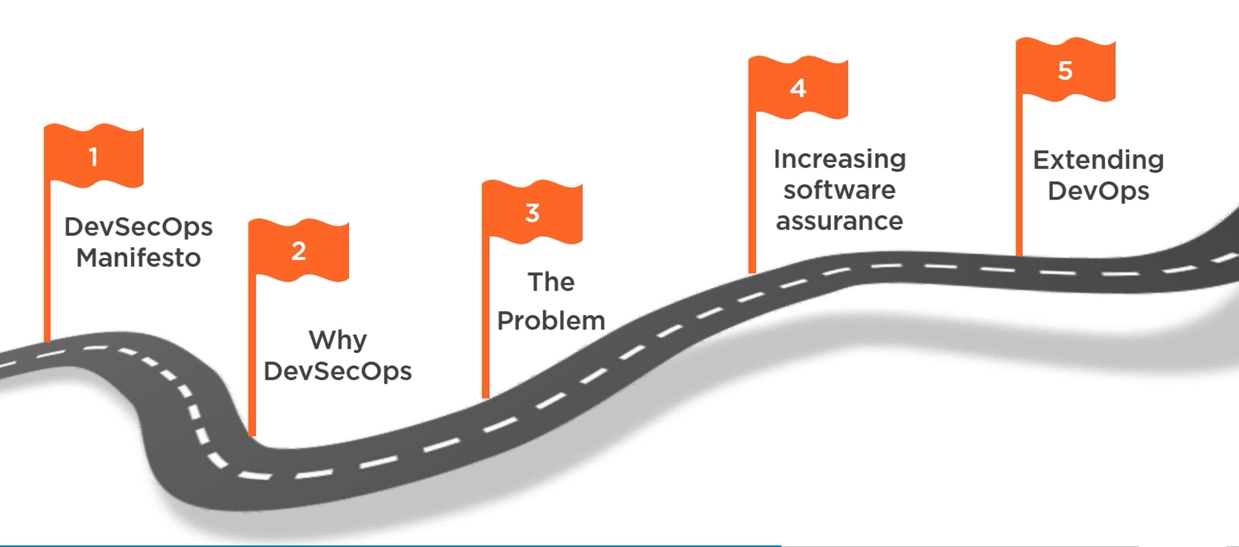
DEVSECOPS
DevSecOps Manifesto
Why DevSecOps?
Problem being solved
How DevOps is Extended with DevSecOps
DevSecOps increases software assurance

Slide 46

DevSecOps Concept
How to incorporate security within agile and DevOps Practices?
The Purpose and intent of DevSecOps is to build on the mindset that "everyone is responsible for security" with the goal of safely distributing security decisionsat speed and scale to those who hold the highest level of context without sacrificing the safety required
https://trends.google.com/trends/explore?date=today%205-y&q=devsecops

Slide 47
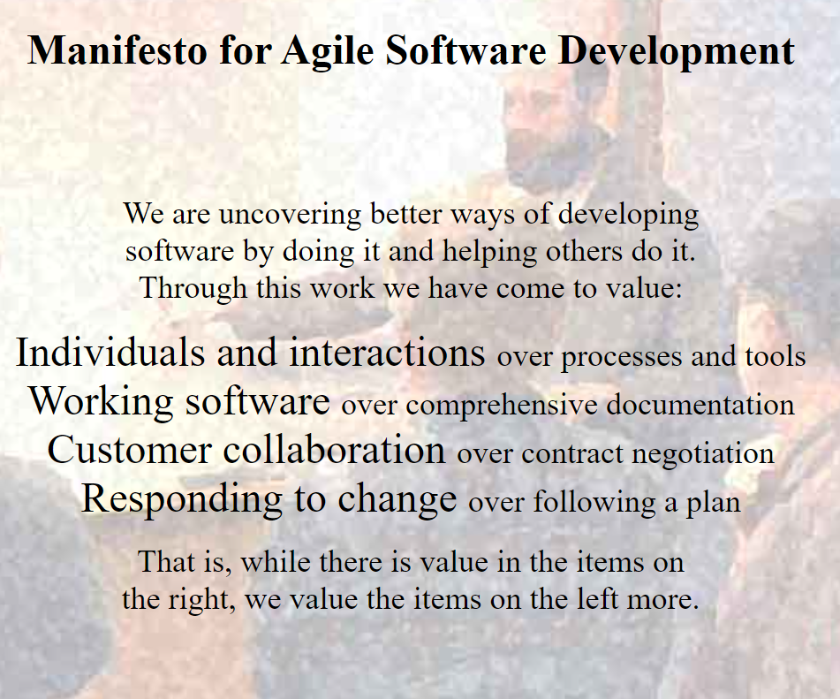
Agile Manifesto
https://agilemanifesto.org/

Slide 48
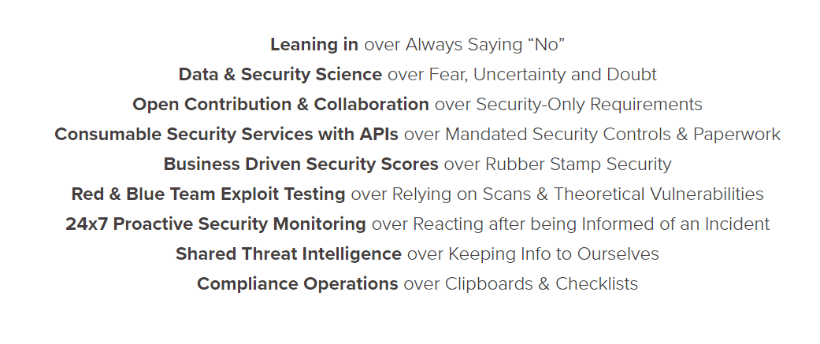
DevSecOps Manifesto
https://www.devsecops.org/

Slide 49
Software Development Evolution

Slide 50
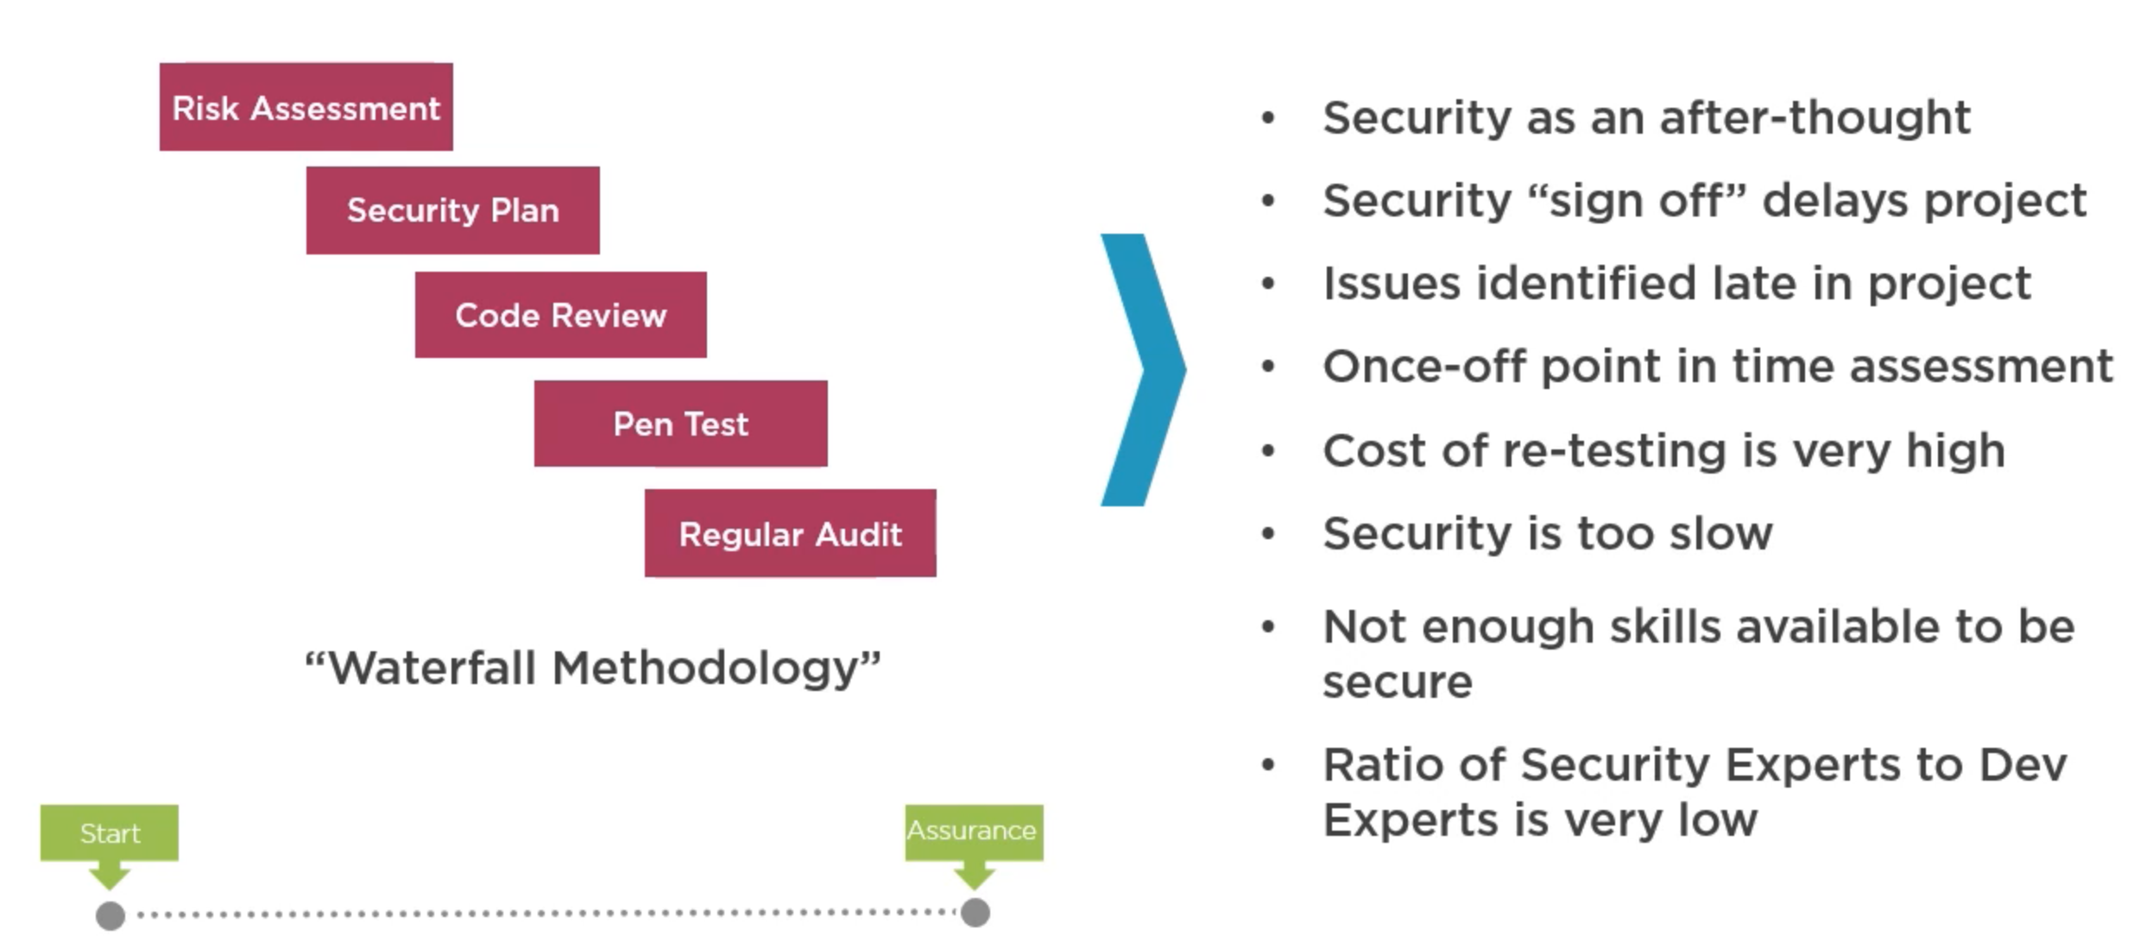
Information Security Friction

Slide 51
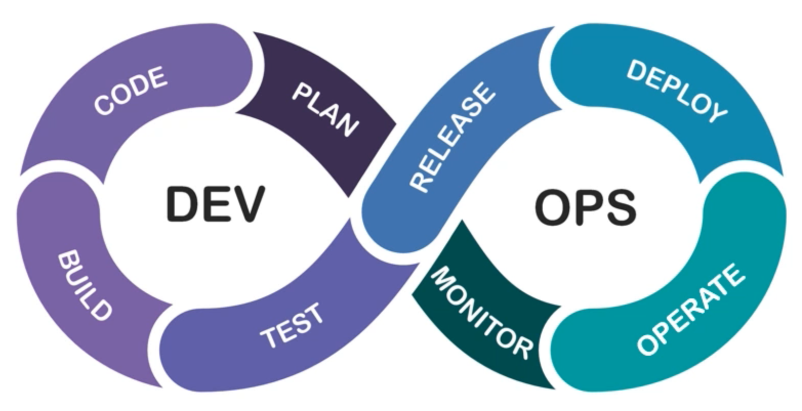
Merge Dev and Ops to Remove Friction

Slide 52
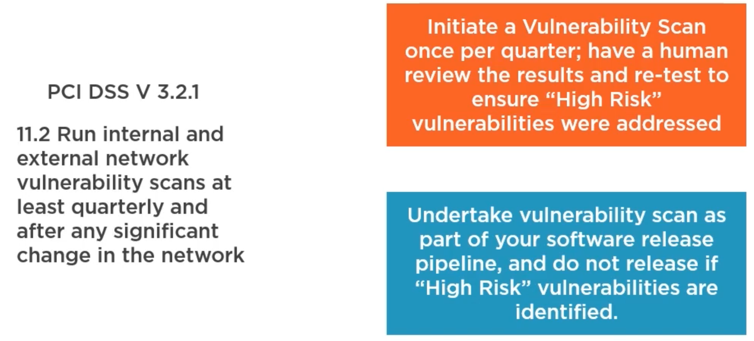
An Example

Slide 53
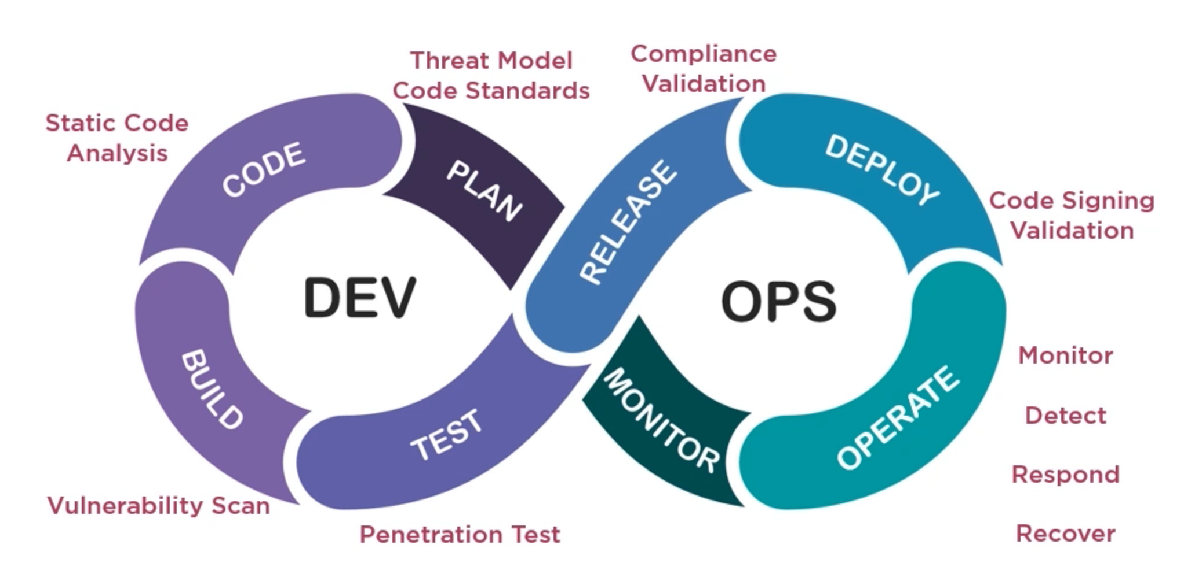
Merge DevOps and Sec to Remove Friction

Slide 54
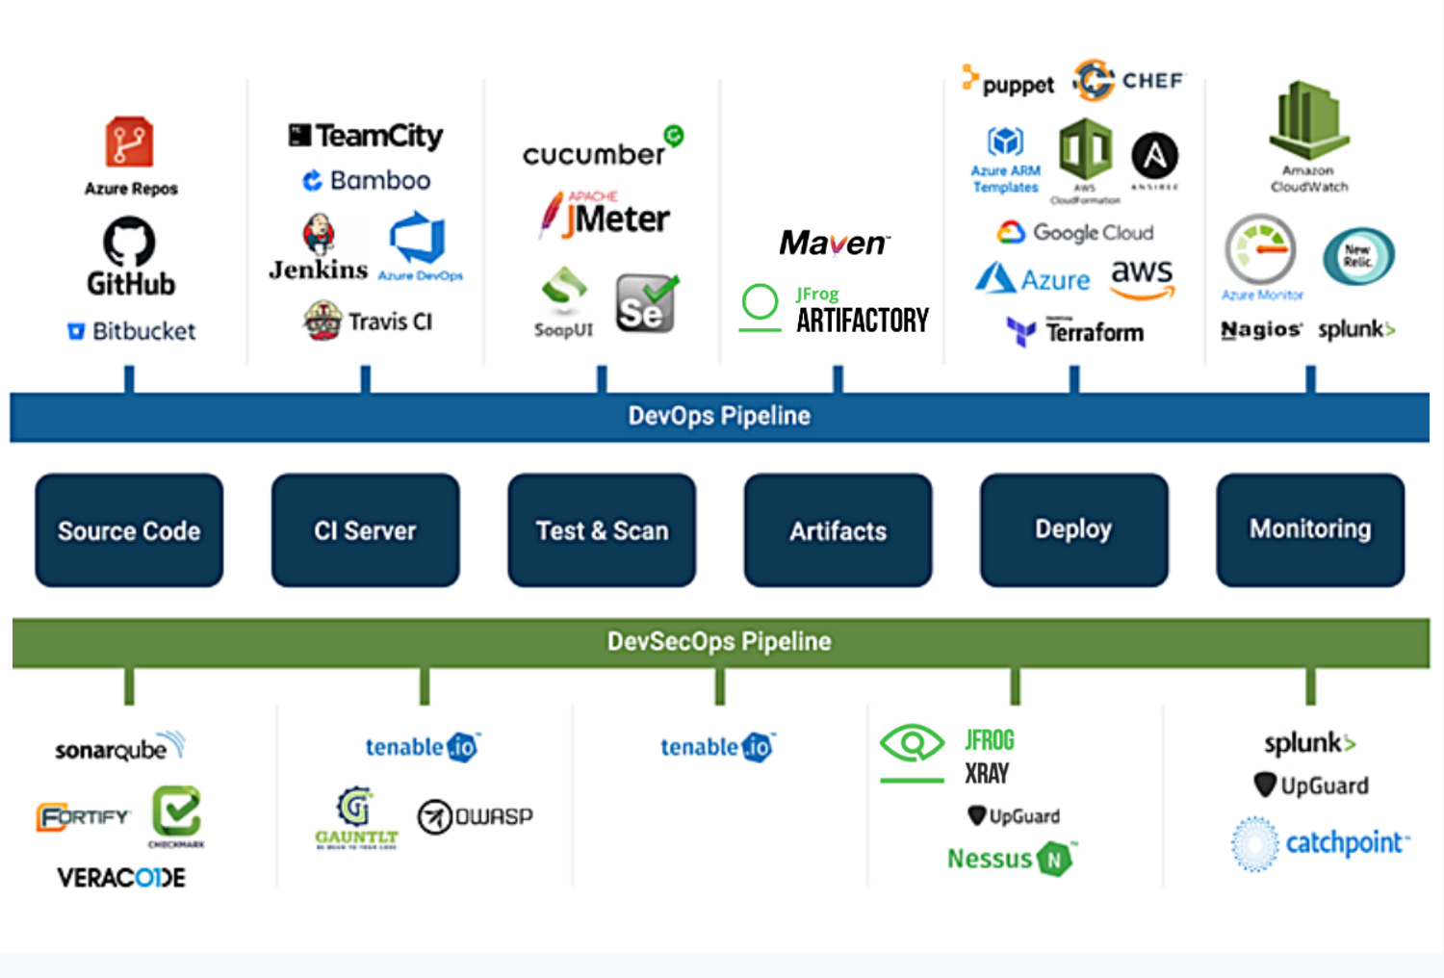

Slide 55
Secured Aspects
Source Code
Application
Containers
Image/Registry
OS
API
Infra
CI / CD Pipeline

Slide 56
How?
Emphasize Developer
Security as a code
Security as a service
Right set of tools
Embed in DevOps (DevSecOps)
Regular training

Slide 57

Security As Code
Code review becomes code preview
Patching becomes build new environment and deploy
Incident Response becomes incident Avoidance using Thread Modelling

Slide 58
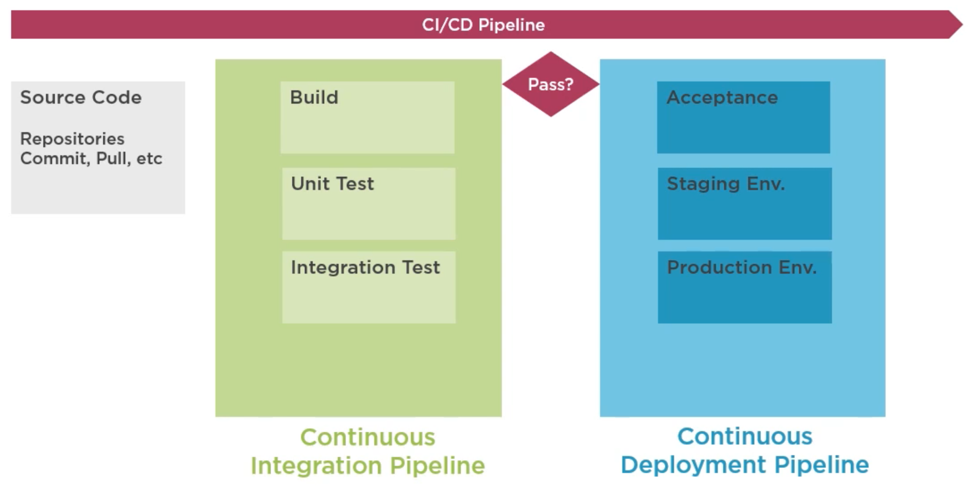
CI/CD Pipeline

Slide 59
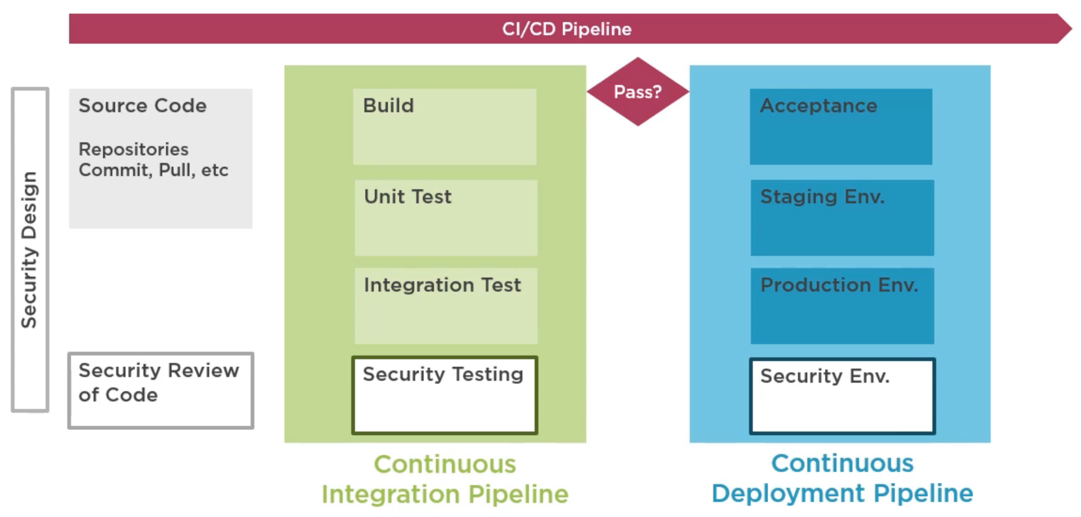
Add Security on CI/CD Pipeline

Slide 60
Add Security on CI/CD Pipeline
Repeatable, Consistent, Embedded Approach
SUSTAINABILITY

Slide 61
DevSecOps Benefits
Where is DevSecOps appropriate
Demonstrate benefits of DevSecOps
Roles & Responsibilities within DevSecOps

Slide 62
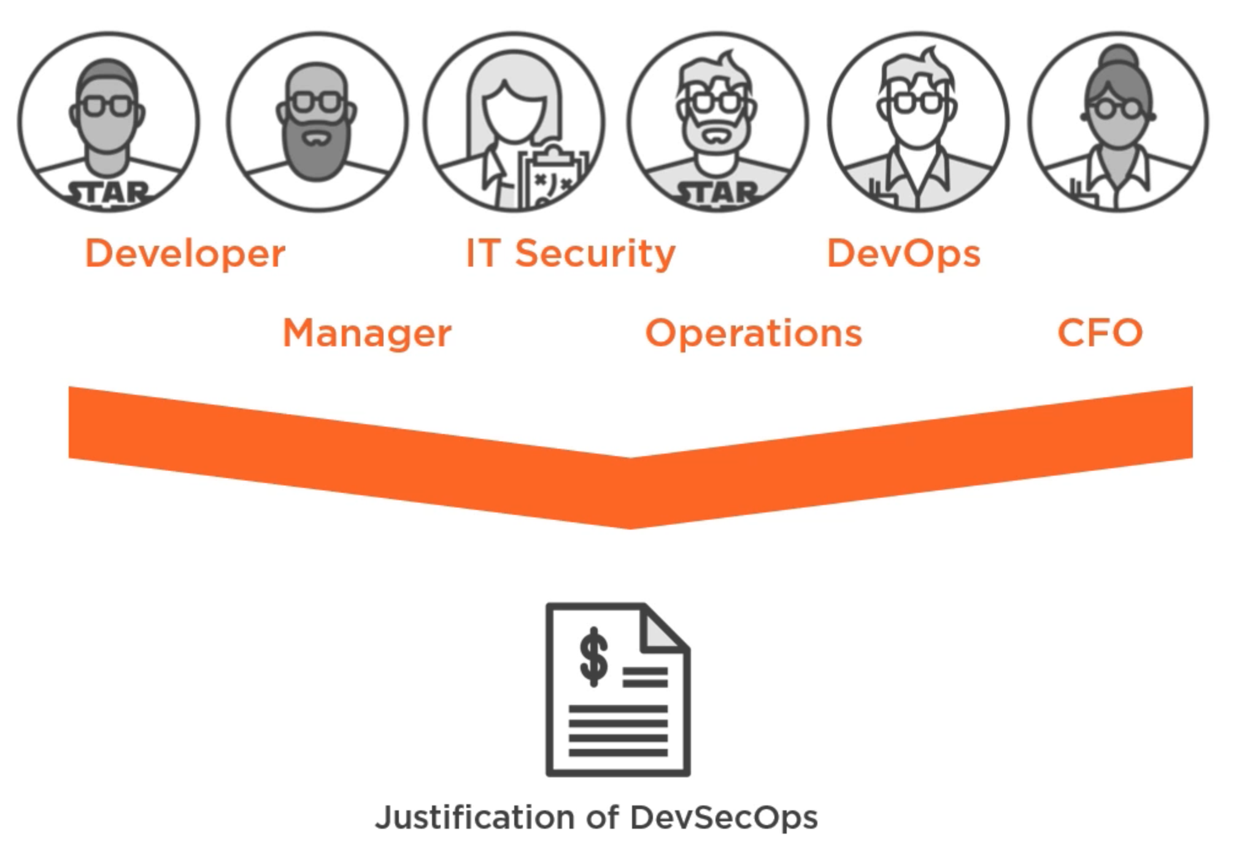

Slide 63
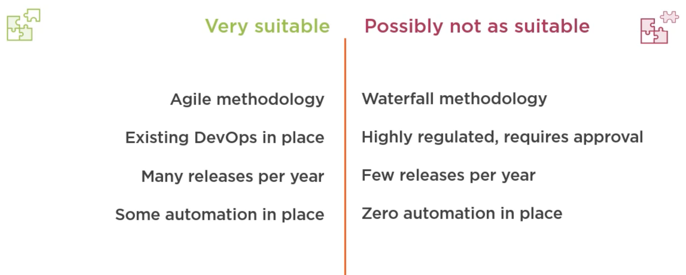
Where DevSecOps Appropriate?

Slide 64
Benefits of DevSecOps Practice
Reduce time on rework for security vulnerabilities
Security issues are found earlier in the lifecycle, reducing the cost of remediation and rework
Reduce risk for Organization and Customers
Increased team collaboration
Consistency in approach - continuous security
Increased compliance levels - "Secure by design"
Better automated security testing and testing helps compliance with various laws.
GDPR - General Data Protection Regulation
CCPA - California Consumer Privacy Act

Slide 65
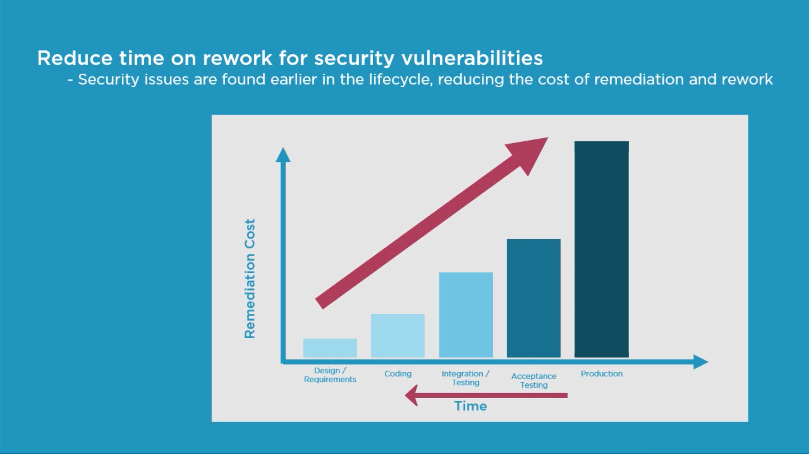

Slide 66
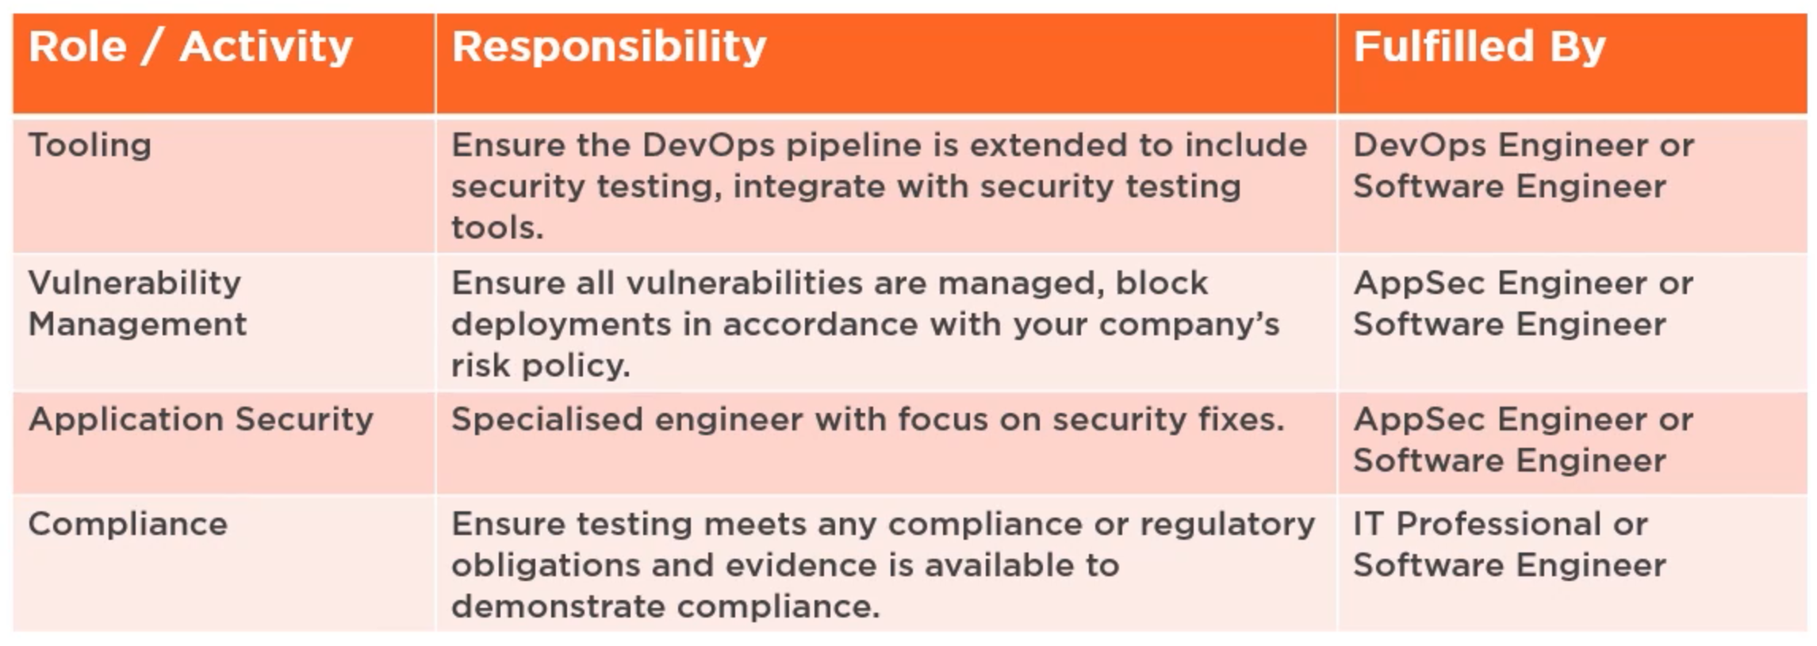
Roles & Responsibilities

Slide 67
Adopting DevSecOps
Positioning DevSecOps in Lifecycle
DevSecOps Maturity Models

Slide 68
Positioning DevSecOps in Lifecycle

Slide 69
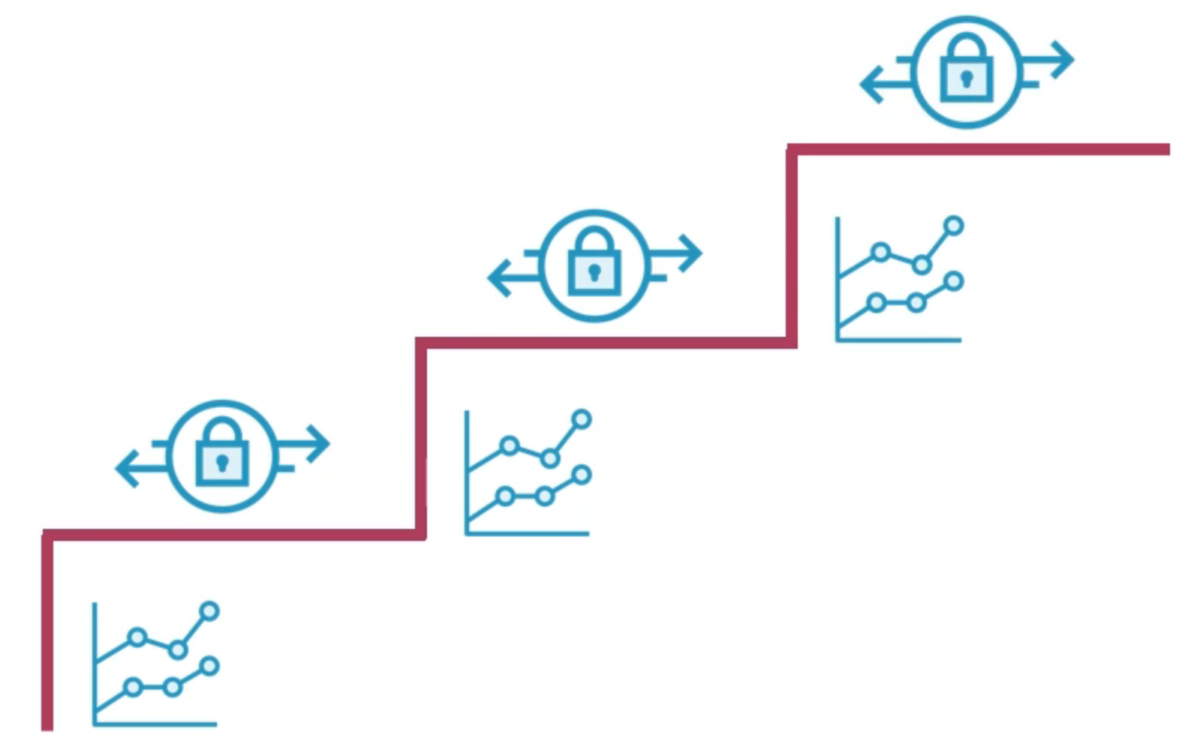
Visible Progress

Slide 70
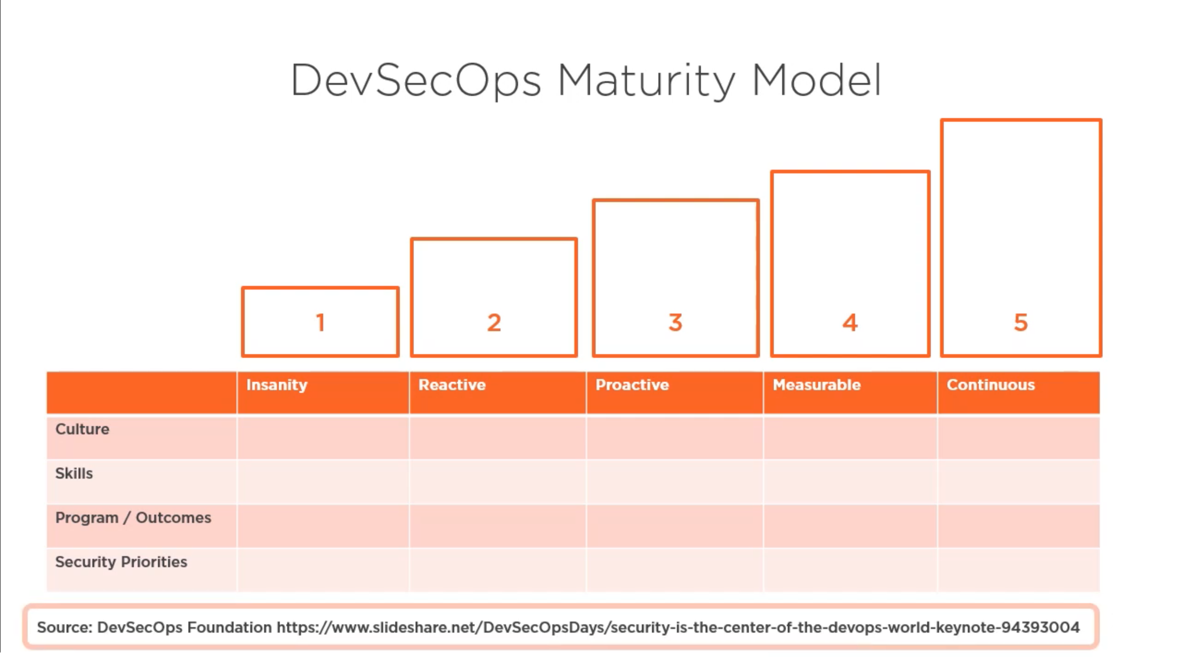

Slide 71
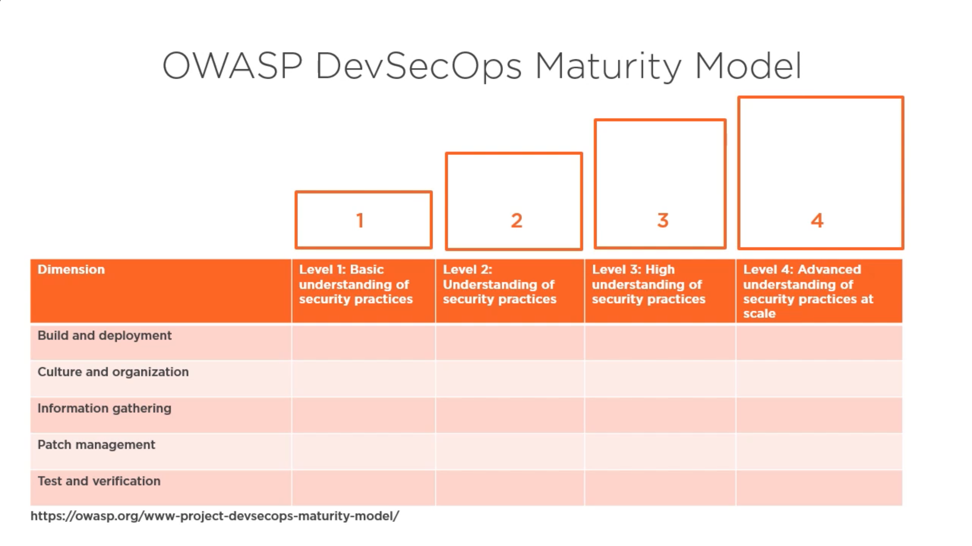

Slide 72
Designing DevSecOps for Plan, Code, Build…
Plan
Code
Build

Slide 73
Positioning DevSecOps in Lifecycle
Security, Visibility & Control

Slide 74


Slide 75


Slide 76
Secure Code Standards
Validate input.
Heed compiler warnings.
Architect and design for security policies.
Keep it simple.
Default deny.
Adhere to the principle of least privilege.
Sanitize data sent to other systems.
Practice defense in depth.
Use effective quality assurance techniques.
Adopt a secure coding standard.
https://wiki.sei.cmu.edu/confluence/display/seccode/Top+10+Secure+Coding+Practices

Slide 77

SAST or SCA

Slide 78
Secure Code Analysis
Features of SAST
Read Source Code
Language specific scanner
False positives
Fast and automated
Finds weaknesses early
https://www.nist.gov/itl/ssd/software-quality-group/source-code-security-analyzers

Slide 79

Vulnerability Scanning (Build)

Slide 80
Designing DevSecOps for Test, Release, Operate
Test
Release
Operate

Slide 81

Test Phase

Slide 82

https://en.wikipedia.org/wiki/Fuzzing

Slide 83

Test Phase

Slide 84

Deploy Phase

Slide 85

SSL Scan

Slide 86

Run Security Hardened Images

Slide 87

Operate Phase

Slide 88

CI / CD Pipeline

Slide 89
Implementation of DevSecOps
Development
Version Control
Pre-Build
Post-Build
QA
Staging
Production
Monitoring
Ide Plugins
Pre-Commit hooks
3rd Part Component Scan
Repository Scan
Secret Management
Static App Security Testing
Dynamic App Security Testing
Container & Cloud Security
Security Testing
3rd Party Component Scan
Manageability Testing
Penetration Testing
IaaS Security
Compliance as Code
Security Monitoring & Alerting

Slide 90

https://digital.ai/periodic-table-of-devops-tools

Slide 91
Questions ???

